Slide 1
BGP
CS 168 – Spring 2020 – Section 5
Notes:
IGP := Murphy’s explanation of how forwarding tables within domain are made
EBGP, IBGP := EBGP, IGBP = communicating destinations in different destinations
these sessions on TCP

Slide 2
Agenda
BGP Basics
Business Relationship among ASes
Basic Messages in BGP
Route attributes
Policy Oscillation
Gao-Rexford Policy

Slide 3
Three parts of BGP
eBGP
Between border routers in different ASes
Learn about external routes
iBGP
Between border routers and other routers within a single AS
Learn which border router to use to reach external destinations
IGP
The protocol used for intradomain routing (e.g. OSPF).
Shortest path to subnet in the same AS
Shortest path to border router for given external network
Just a different name for L3 routing as we’ve talked about earlier

Slide 4
The Big Picture
How does this fit with what we’ve learned so far?

Slide 5

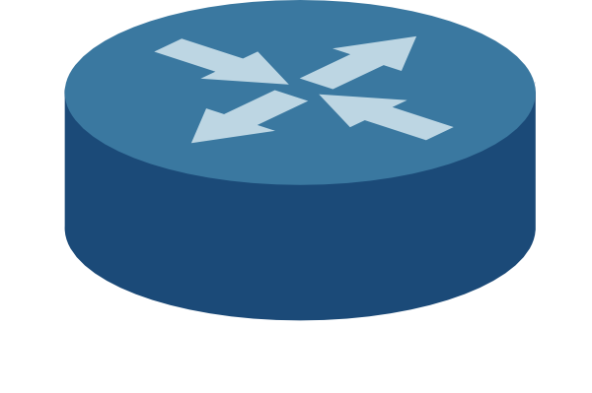
L2: LAN
Destinations are MAC addresses
Learning switches
Default gateway
3rd floor Soda
1.2.4/24
Host
IP: 1.2.3.6
MAC: …
Default gateway
Subnet (4th floor Soda)
1.2.3/24
Default gateway
7th floor Soda
1.2.5/24
Host (you)
IP: 1.2.3.4
MAC: 01:0a:00:00:0b:02
Host
IP: 1.2.3.5
MAC: …
LAN

Slide 6
Domain (AS)
UC Berkeley
IP prefix: 1.2/16
L3: Intradomain
Destinations are IP addresses
IGP: exchange info about paths to local destinations
DV routing and friends
3rd floor Soda
1.2.4/24
4th floor Soda
1.2.3/24
7th floor Soda
1.2.5/24
LAN: Intradomain

Slide 7
Domain (AS)
Border router
Border router
UC Berkeley
IP prefix: 1.2/16
Google
7.8/16
Border router
Border router
3rd floor Soda
1.2.4/24
MIT
5.6/16
Border router
4th floor Soda
1.2.3/24
7th floor Soda
1.2.5/24
AT&T
3.4/16
WAN: Interdomain

Slide 8

Domain (AS)
UC Berkeley
AS number: 1
IP prefix: 1.2/16
From: AT&T
5.6/16
Path: {3,2}
Google (4)
7.8/16
Interdomain: eBGP
Between border routers in different ASes
Learn about routes to external networks
Destinations are IP prefixes
3rd floor Soda
1.2.4/24
MIT (3)
5.6/16
4th floor Soda
1.2.3/24
7th floor Soda
1.2.5/24
AT&T (2)
3.4/16
WAN: Interdomain

Slide 9
Domain (AS)
UC Berkeley
AS number: 1
IP prefix: 1.2/16
Google (4)
7.8/16
Interdomain: eBGP
Between border routers in different ASes
Learn about routes to external networks
Destinations are IP prefixes
3rd floor Soda
1.2.4/24
MIT (3)
5.6/16
From: MIT
5.6/16
Path: {3}
4th floor Soda
1.2.3/24
7th floor Soda
1.2.5/24
AT&T (2)
3.4/16
WAN: Interdomain

Slide 10
Soda → MIT
LAN
LAN
Default gateway
Default gateway
4th floor Soda
2nd floor CSAIL
Border router
Border router
UC Berkeley
ASes
MIT

Slide 11

Domain (AS)
UC Berkeley
Intradomain: iBGP
Border routers and other routers within a single AS
To which border router should I send packets for MIT?
3rd floor Soda
1.2.4/24
4th floor Soda
1.2.3/24
7th floor Soda
1.2.5/24
iBGP

Slide 12
Path-Vector (BGP) vs. Distance-Vector
Send paths
All hops to destination
May choose other than shortest path
Base choices on policy instead
Selective route advertisement
Route aggregation
Combine prefixes if possible
Destination based
No global view of network
Iterative, distributed convergence
Send distances
Shortest path metric
Send all updates to neighbors
No route aggregation

Slide 13
Path Vector
AS 1 1.2/16
AS 2
AS 3
1.2/16
Path: {1}
1.2/16
Path: {2,1}

Slide 14
Not Picking Shortest Route
AT&T
(1)
Facebook
(2)
Google
(3)
AT&T may pick path {1, 2, 3} over {1, 3}

Slide 15
Route Aggregation
Combine prefixes
Scalability
1.0.0.0/8
This way!
AT&T
1.0.0.0/8
UC Berkeley
1.2.0.0/16
Stanford
1.3.0.0/16
Google
1.4.0.0/16

Slide 16
Selective Route Advertisement
AS may advertise routes to only some neighbors
Based on policies
AT&T
Facebook
Google

Slide 17
Selective Route Advertisement
E.g. Facebook might not want to carry traffic between AT&T and Google
Don’t tell AT&T about path to Google
Don’t tell Google about path to AT&T
AT&T
Facebook
Google

Slide 18
Questions?

Slide 19
Export & Selection
If you are an AS:
Route Selection
Where you send your packets
Determine how to choose a valid route to a given IP prefix, when multiple paths through ASes
Route Export
Which ASes will receive your route
Other ASes will select your route and send traffic to you

Slide 20

Export & Selection
UCB and Facebook export their route to Stanford
They agree to carry AT&T’s traffic to Stanford
Stanford this way!
UC Berkeley
Google
AT&T
Stanford this way!
Facebook
Comcast

Slide 21
Export & Selection
AT&T selects route through UC Berkeley
AT&T might now send traffic to Stanford via UCB
UC Berkeley
Stanford this way!
Google
AT&T
Facebook
Comcast

Slide 22
Export & Selection
AT&T exports route to Google only
Agrees to carry Google’s traffic to Stanford, but not Comcast’s
UC Berkeley
Stanford this way!
Google
AT&T
Facebook
Comcast

Slide 23
Basic Messages in BGP
Open: establishes BGP session
Notification: report unusual conditions
Update:
Format <IP prefix: route attributes>
Inform neighbors of new routes (announcements)
Inform neighbors of old routes that are no longer active (withdrawal)
Keepalive:
Inform neighbors that this BGP session is still alive
What’s this?
Notes:
route attributes describe property of the route like ASPATH, LOCALPREF, etc.
for this only message we care about are updates

Slide 24
BGP Route Attributes
Local attributes
ASes keep them private
Not included in eBGP route announcements
E.g. LOCAL_PREF
Nonlocal attributes:
propagated with eBGP route announcements
E.g. AS_PATH

Slide 25
Route Selection in Priority Order
Priority | Rule | Remarks
1 | LOCAL PREF | Pick highest LOCAL PREF
2 | ASPATH | Pick shortest ASPATH length
3 | IGP path | Lowest IGP cost to next hop (egress router)
4 | MED | Lowest MED preferred
5 | Router ID | Smallest next-hop router’s IP address as tie-breaker
Notes:
Multi-Exit Discriminator preferred output packet
iBGP path is to get the packet out quickly
Deeper slides are Hidden out
TABLE from LECTURE Priority Rule Remarks
1 LOCAL PREF Pick highest LOCAL PREF
2 ASPATH Pick shortest ASPATH length
3 IGP path Lowest IGP cost to next hop
(egress router)
4 MED MED preferred
5 Router ID Smallest next-hop router’s IP
address as tie-breaker

Slide 26
Types of ASes (domains)
Stub: only sends/receives traffic for its users
companies, universities, etc.
Transit: carries traffic for other ASes
Global ISPs (Tier 1): fully connected mesh
Regional ISPs (Tier 2)
Local ISPs (Tier 3)
Lower tiers buy service from higher tiers
What’s the relationship between AS and ISP?
All ISPs are ASes, but not all ASes are ISPs
E.g. UC Berkeley is not an ISP but it is an AS

Slide 27
Business Relationship among ASes
Two ASes will connect only if they have business relationship:
Customer-Provider
Provider B carries customer A’s traffic for a fee
Peers
Peers A, B carry each other’s traffic for free
What roles can a global ISP (Tier 1) have?
Provider to Tier 2 or Tier 3
Peer to other global ISP (tier 1)
Not a customer!

Slide 28

Business Relationship Restrictions
The graph of peering relations can be cyclic
The peer of my peer can also be my peer
For example, global ISPs all peer with each other
The graph of customer-provider relations must be acyclic

Slide 29
BGP Route Attributes Continued …
AS_PATH (nonlocal attribute, mandatory)
Insert ASN of traversed AS to BGP’s path vector in reverse order
The fewer ASes traversed, the better
Berkeley
(25)
Amazon exports its route using eBGP with attribute AS_PATH {16, 56}
Google exports its route using eBGP with attribute AS_PATH {16, 56, 10}
Comcast
(16)
Amazon
(56)
Google
(10)
Notes:
Multi-Exit Discriminator

Slide 30
BGP Route Attributes Continued …
LOCAL_PREF (local attribute)
Propagated through iBGP
Used to choose different AS paths
Default preference 100
The higher the value, the more preferred
Highest priority among all other attributes
How AS prefer customers to peers to providers
Default 100
AS_PATH | LOCAL_PREF
{16, 56}
{16, 56, 10} | 120
{16} | 50
{16, 56, 10, 5} | 200
Pick Highest
Berkeley kept all paths to some IP prefix in Comcast’s AS (ASN 16)
Notes:
Multi-Exit Discriminator

Slide 31
BGP Route Attributes Continued …
MED (nonlocal attribute)
Used when ASes are connected via 2 or more links
Allows AS to inform its immediate neighbors of its preferred entry points
The lower the value, the more preferred
Default 100
AS_PATH | LOCAL_PREF | MED
{16, 56} |  | 20
{16, 10} | 100 | 5
{16, 35} | 50 | 15
Same local preferences
Same # of ASes traversed
Pick Lowest
Notes:
Multi-Exit Discriminator

Slide 32
BGP Route Attributes Continued …
IGP cost (local attribute)
Used for hot-potato routing (AS wants to get rid of the packet ASAP)
minimize use of my network bandwidth (“hot potato”)
may conflict with MED (the route may not be preferred)
Notes:
Multi-Exit Discriminator

Slide 33
Policy Oscillation
Notes:
STOP HERE
Cover worksheet first, then come back if there’s time (Sylvia will cover this in lecture)
Multi-Exit Discriminator

Slide 34
Policy Oscillation
Each node prefers route through neighbor over direct route.
1
Suppose initially each node only knows the shortest path to 0 (green arrow).
1 prefers reaching 0 through 2 or 3
2 prefers reaching 0 through 1 or 3
3 prefers reaching 0 through 1 or 2
0
1 knows 1→0
2 knows 2→0
3 knows 3→0
2
3

Slide 35
Policy Oscillation 1
Each node prefers route through neighbor over direct route.
1
Suppose initially each node only knows the shortest path to 0 (green arrow).
1 prefers reaching 0 through 2 or 3
2 prefers reaching 0 through 1 or 3
3 prefers reaching 0 through 1 or 2
0
1 knows 1→0
2 knows 2→0
3 knows 3→0
2
3
1 advertises its path to 0 to 2: 1->0

Slide 36
Policy Oscillation 2
Each node prefers route through neighbor over direct route.
1
Suppose initially each node only knows the shortest path to 0 (green arrow).
1 prefers reaching 0 through 2 or 3
2 prefers reaching 0 through 1 or 3
3 prefers reaching 0 through 1 or 2
0
1 knows 1→0
2 knows 2→0
3 knows 3→0
2
3
3 advertises its path of 0 to 1: 3->0

Slide 37
Policy Oscillation 3
Each node prefers route through neighbor over direct route.
1
Suppose initially each node only knows the shortest path to 0 (green arrow).
1 prefers reaching 0 through 2 or 3
2 prefers reaching 0 through 1 or 3
3 prefers reaching 0 through 1 or 2
0
1 knows 1→0
2 knows 2→0
3 knows 3→0
2
3
1 withdraws its path of 0 to 2: 1->0 (because 1 now takes 1->3->0)

Slide 38
Policy Oscillation 4
Each node prefers route through neighbor over direct route.
1
Suppose initially each node only knows the shortest path to 0 (green arrow).
1 prefers reaching 0 through 2 or 3
2 prefers reaching 0 through 1 or 3
3 prefers reaching 0 through 1 or 2
0
1 knows 1→0
2 knows 2→0
3 knows 3→0
2
3
2 now advertises its path of 0 to 3: 2->0
(3 would take it as it favors its neighbor)

Slide 39
Policy Oscillation 5
Each node prefers route through neighbor over direct route.
1
Suppose initially each node only knows the shortest path to 0 (green arrow).
1 prefers reaching 0 through 2 or 3
2 prefers reaching 0 through 1 or 3
3 prefers reaching 0 through 1 or 2
0
1 knows 1→0
2 knows 2→0
3 knows 3→0
2
3
3 now withdraws its path of 0 to 1: 3->0

Slide 40
Policy Oscillation 6
Each node prefers route through neighbor over direct route.
1
Suppose initially each node only knows the shortest path to 0 (green arrow).
1 prefers reaching 0 through 2 or 3
2 prefers reaching 0 through 1 or 3
3 prefers reaching 0 through 1 or 2
0
1 knows 1→0
2 knows 2→0
3 knows 3→0
2
3
1 again advertises its path of 0 to 2: 1->0

Slide 41
Policy Oscillation 7
Each node prefers route through neighbor over direct route.
1
Suppose initially each node only knows the shortest path to 0 (green arrow).
1 prefers reaching 0 through 2 or 3
2 prefers reaching 0 through 1 or 3
3 prefers reaching 0 through 1 or 2
0
1 knows 1→0
2 knows 2→0
3 knows 3→0
Back to where we started!
2
3
2 withdraws its path of 0 to 3: 2->0

Slide 42
Why doesn’t this happen in reality?
Gao-Rexford

Slide 43
Gao-Rexford Policy
Destination prefix advertised by… | Export route to…
Customer | Everyone (providers, peers, other customers)
Peer | Customers
Provider | Customers
Notes:
Multi-Exit Discriminator

Slide 44
Gao-Rexford Policy Continued
Green arrow is where you learn the route
Orange arrows are where you export the route
With Gao-Rexford
The AS policy graph is a DAG
Routes are “valley free”/”single-peaked”
providers
peers
customers
Notes:
Multi-Exit Discriminator

Slide 45
Gao-Rexford avoids Policy Oscillation
Example shown before did not use Gao-Rexford (why?)
1, 2, and 3 are peers
0 is the provider to 1, 2, and 3
Peers don’t advertise route learned from providers to each other
i.e. 1 would never advertise 1->0 (learned from 1’s provider 0) to 2 (1’s peer)
1
0
2
3
Destination prefix advertised by… | Export route to…
Peer | Customers

Slide 46
Questions?

Slide 47
Worksheet

Slide 48
Question 1
iBGP is used for Intradomain Routing.
False: IGP (OSPF or RIP) are used for Intradomain
Avoiding loops is one reason why BGP uses path vector.
True: Also helps ASes adopt certain policies
BGP always advertises a shortest path.
False: The path relies on various other metrics
BGP route advertisements use classless addressing.
True

Slide 49
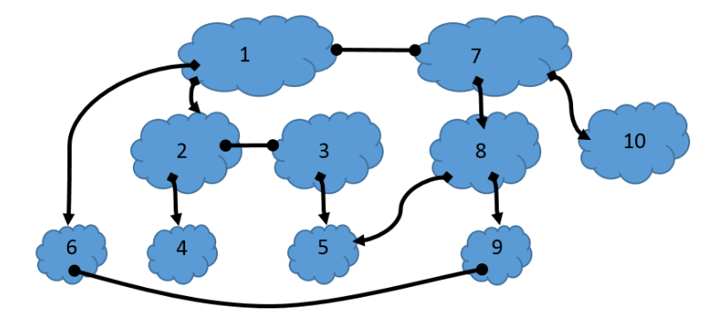
Question 3

Slide 50
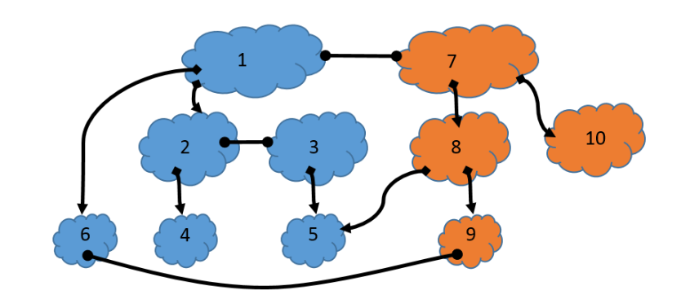
Question 3

